Slide 1

Chapter 15
Connecting LANs,
Backbone Networks,
and Virtual LANs
15.<number>
Copyright © The McGraw-Hill Companies, Inc. Permission required for reproduction or display.

Slide 2
15-1 CONNECTING DEVICES
In this section, we divide connecting devices into five different categories based on the layer in which they operate in a network.
Topics discussed in this section:
Passive Hubs
Active Hubs
Bridges
Two-Layer Switches
Routers
Three-Layer Switches
Gateways
15.<number>

Slide 3

Figure 15.1 Five categories of connecting devices
15.<number>

Slide 4
Passive Hubs
Just a connector
Connects different branches
15.<number>

Slide 5

Figure 15.2 A repeater connecting two segments of a LAN
Operates on physical layer
Install at different distances
Regenerates the signals
Connect two segments of a same LAN, not two LANs
Can not connect different protocols
10base5…..length extend..how?
A repeater forwards every frame;
it has no filtering capability.
A repeater is a regenerator,
not an amplifier.
15.<number>

Slide 6

Figure 15.3 Function of a repeater
15.<number>

Slide 7

Active Hubs
Operates on physical layer
Multiport repeater
15.<number>

Slide 8
Bridges
Operates on physical layer and data link layer
PL…Regenerates the signal
DLL…..can check MAC (Media Access Control )of frame
A bridge has a table used in filtering decisions…. Frame should be forwarded or dropped
Forward frame…which port?
15.<number>

Slide 9

Figure 15.5 A bridge connecting two LANs
15.<number>

Slide 10

Note
A bridge does not change the physical (MAC) addresses in a frame.
15.<number>

Slide 11
Transparent Bridges
Station are unaware
If remove…no need of reconfiguration
Three criteria
  Frame forwarding
  Automated Filtering table….manual entry in earlier bridges
  Loop prevented…because of the two same bridges installation… for the purpose of backup
    Spanning tree implementation
    Loop less
15.<number>

Slide 12

Figure 15.6 A learning bridge and the process of learning
15.<number>

Slide 13
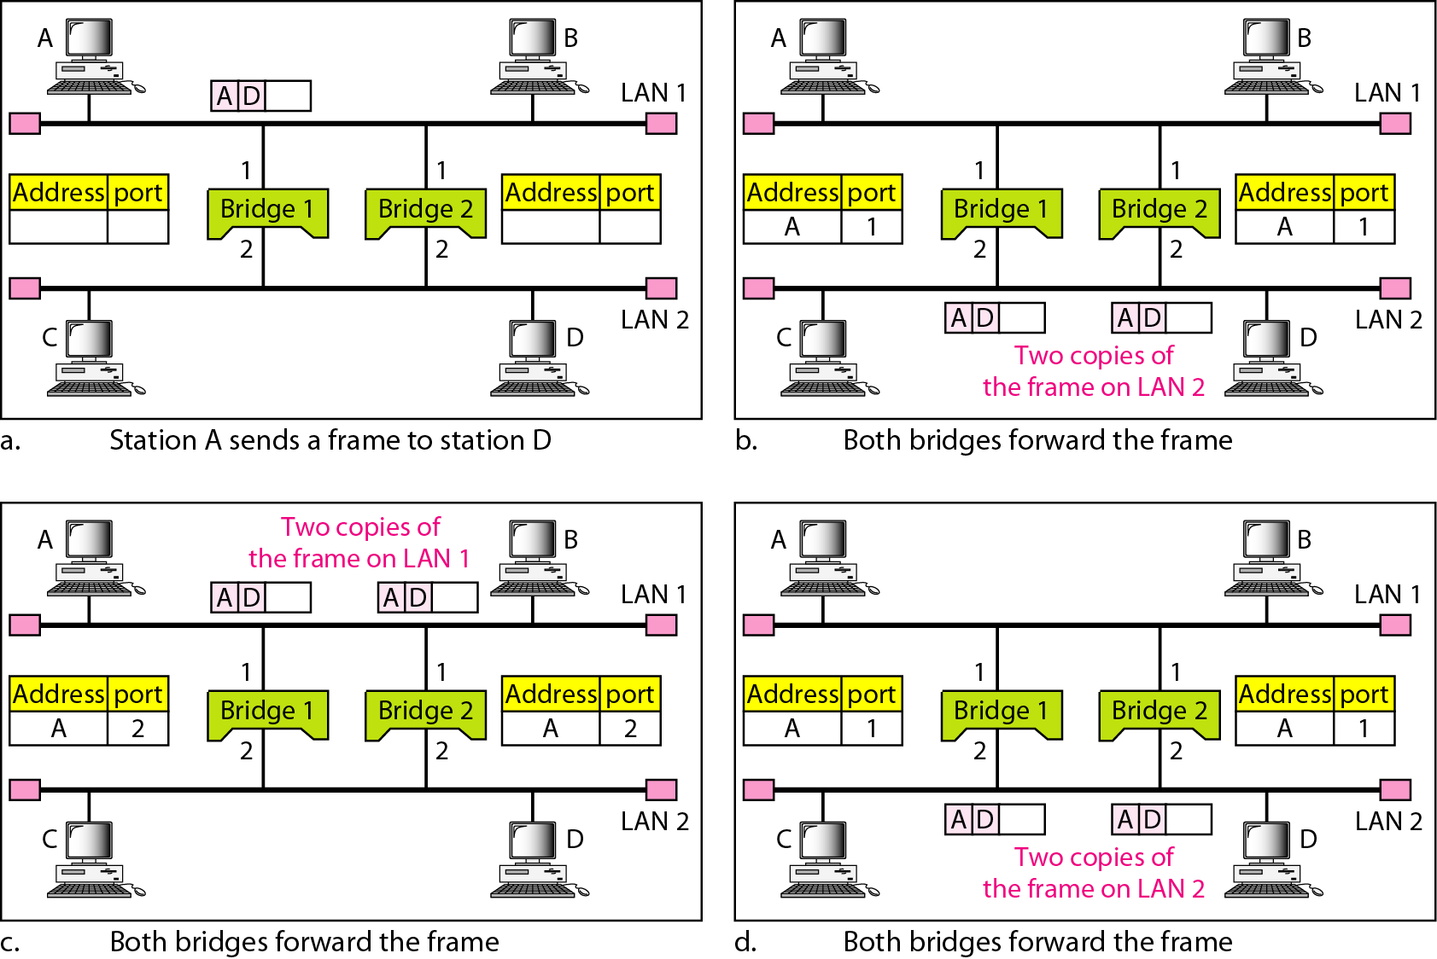
Figure 15.7 Loop problem in a learning bridge
15.<number>

Slide 14
Two layer Switch
Physical and data link layer
Bridge with many ports
15.<number>

Slide 15
Router
Physical, data link layer and network layer
Logical addressing… host-to-host
Routing table…dynamic…creation? Network part
Connect LAN, WAN in internets
15.<number>

Slide 16

Figure 15.11 Routers connecting independent LANs and WANs
15.<number>

Slide 17
Gateway
Similar to routers
Work on all five layers
Connect two internet works
15.<number>

Slide 18
15-3 VIRTUAL LANs
We can roughly define a virtual local area network (VLAN) as a local area network configured by software, not by physical wiring.
15.<number>

Slide 19
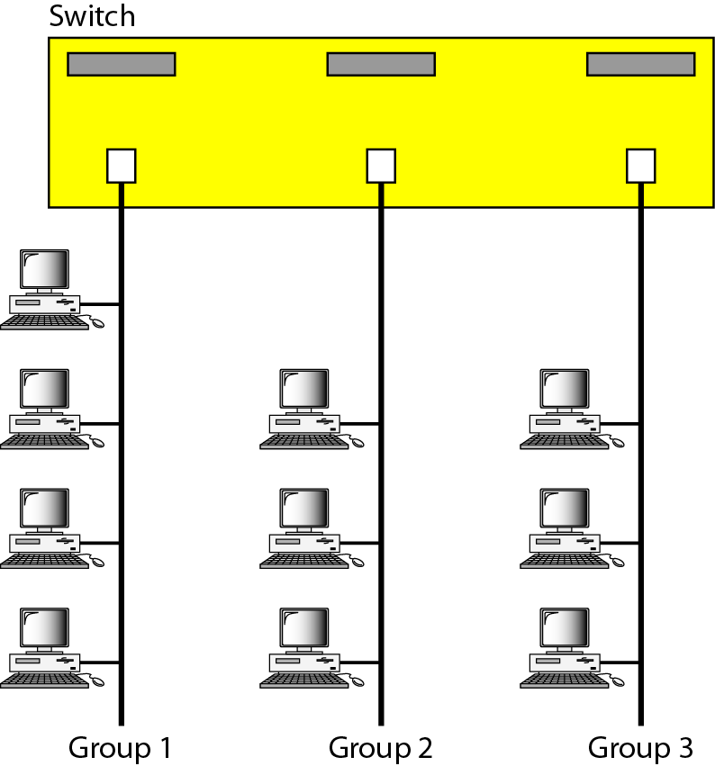
Figure 15.15 A switch connecting three LANs
15.<number>

Slide 20

Figure 15.16 A switch using VLAN software
15.<number>

